Slide 1
Accounting Principles, 7th Edition
Weygandt • Kieso • Kimmel
Chapter 5
Accounting for Merchandising Operations
Prepared by Naomi Karolinski
Monroe Community College
and
Marianne Bradford
Bryant College
John Wiley & Sons, Inc. © 2005

Slide 2
CHAPTER 5 ACCOUNTING FOR MERCHANDISING OPERATIONS
After studying this chapter, you should be able to:
1 identify the differences between a service enterprise and a merchandising company
2 explain the entries for purchases under a perpetual inventory system
3 explain the entries for sales revenues under a perpetual inventory system
4 explain the steps in the accounting cycle for a merchandising company

Slide 3
CHAPTER 5
ACCOUNTING FOR MERCHANDISING
OPERATIONS
After studying this chapter, you should be able to:
5 distinguish between a multiple-step and a single-step income statement
6 explain the computation and importance of gross profit
7 determine the cost of goods sold under a periodic system

Slide 4

MERCHANDISING COMPANY
A merchandising company buys and sells goods to earn a profit.
1) Wholesalers sell to retailers
2) Retailers sell to consumers
Primary source of revenue is Sales

Slide 5
MEASURING NET INCOME
Expenses for a merchandiser are divided into two categories:
1 Cost of goods sold
  The total cost of merchandise sold during the period
2 Operating expenses
  Expenses incurred in the process of earning sales revenue (Examples: sales salaries and insurance expense)
Gross profit is equal to Sales Revenue less Cost of Goods Sold

Slide 6
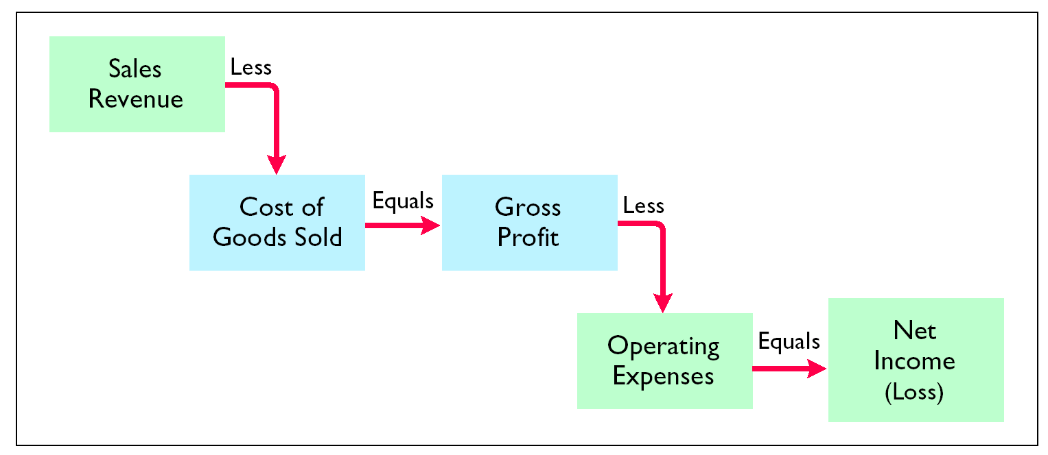
INCOME MEASUREMENT PROCESS FOR A MERCHANDISING COMPANY

Slide 7
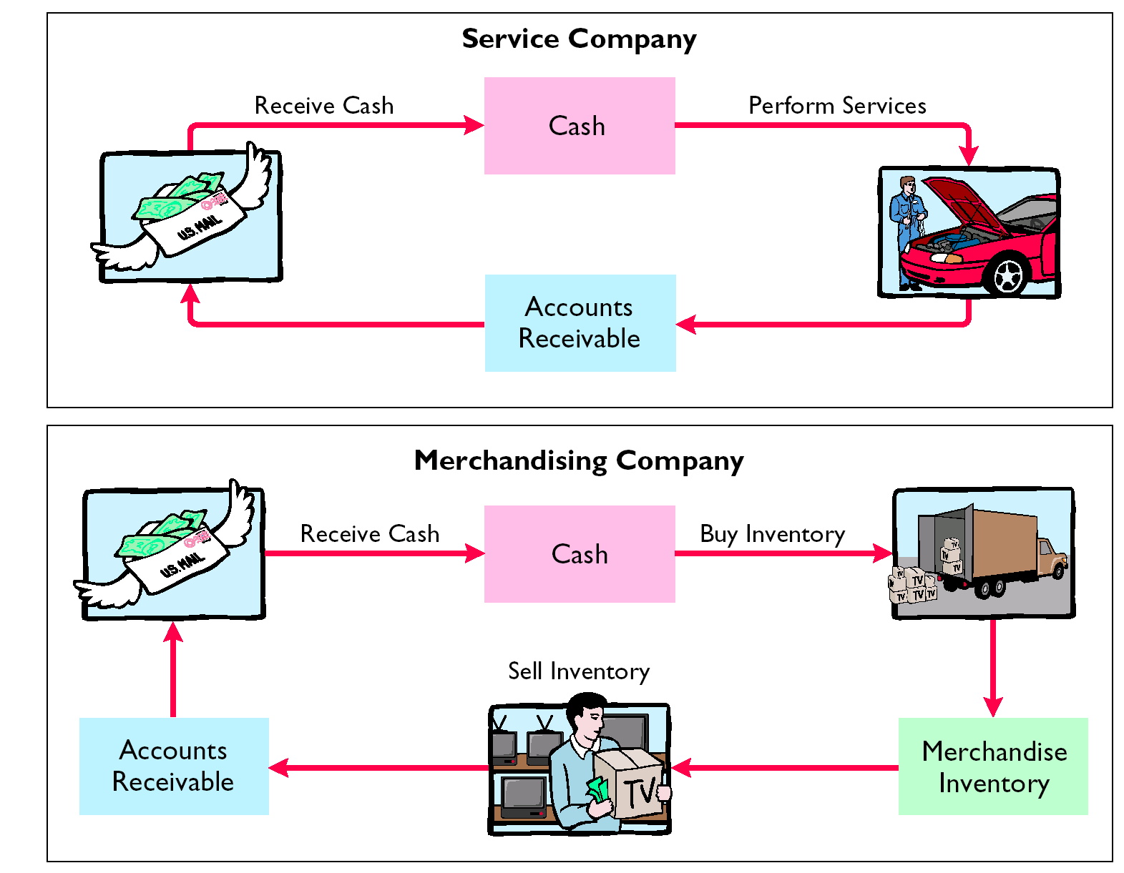
OPERATING CYCLES FOR A SERVICE COMPANY AND A MERCHANDISING COMPANY

Slide 8
INVENTORY SYSTEMS
Merchandising entities may use either:
1) Perpetual Inventory
Detailed records of the cost of each item are maintained, and the cost of each item sold is determined from records when the sale occurs.
2) Periodic Inventory
Cost of goods sold is determined only at the end of an accounting period.

Slide 9
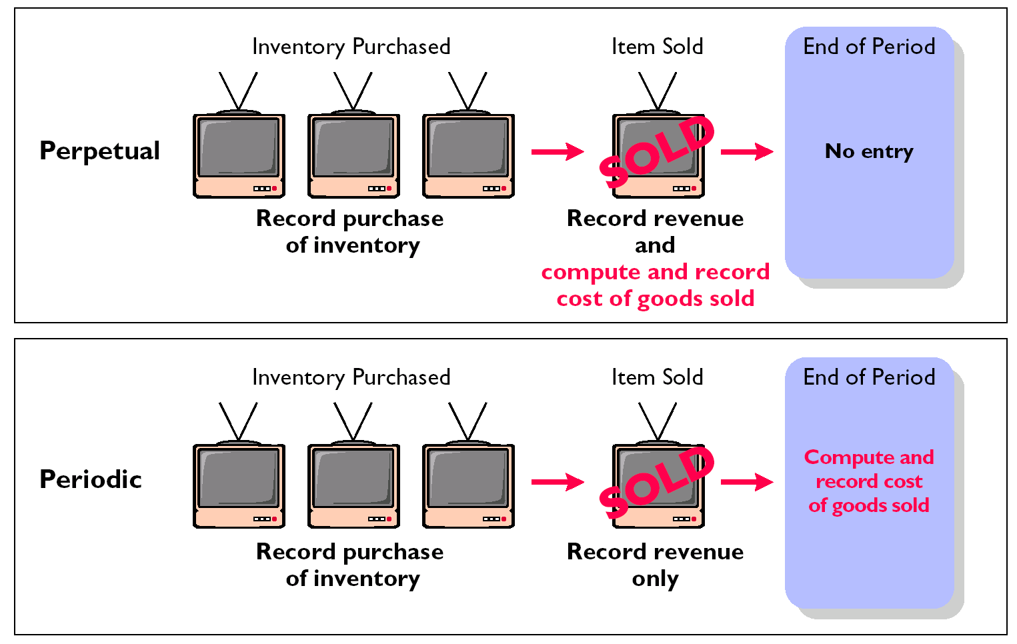
PERPETUAL VS. PERIODIC

Slide 10
COST OF GOODS SOLD
To determine the cost of goods sold under a periodic inventory system:
1) Determine the cost of goods on hand at the beginning of the accounting period,
2) Add to it the cost of goods purchased, and
3) Subtract the cost of goods on hand at the end of the accounting period.

Slide 11

PURCHASES OF MERCHANDISE
STUDY OBJECTIVE 2
Merchandise is purchased for resale to customers, the account
  Merchandise Inventory is debited for the cost of goods.
Like sales, purchases may be made for cash or on account (credit).
The purchase is normally recorded by the purchaser when the goods are received from the seller.
Each credit purchase should be supported by a purchase invoice.

Slide 12
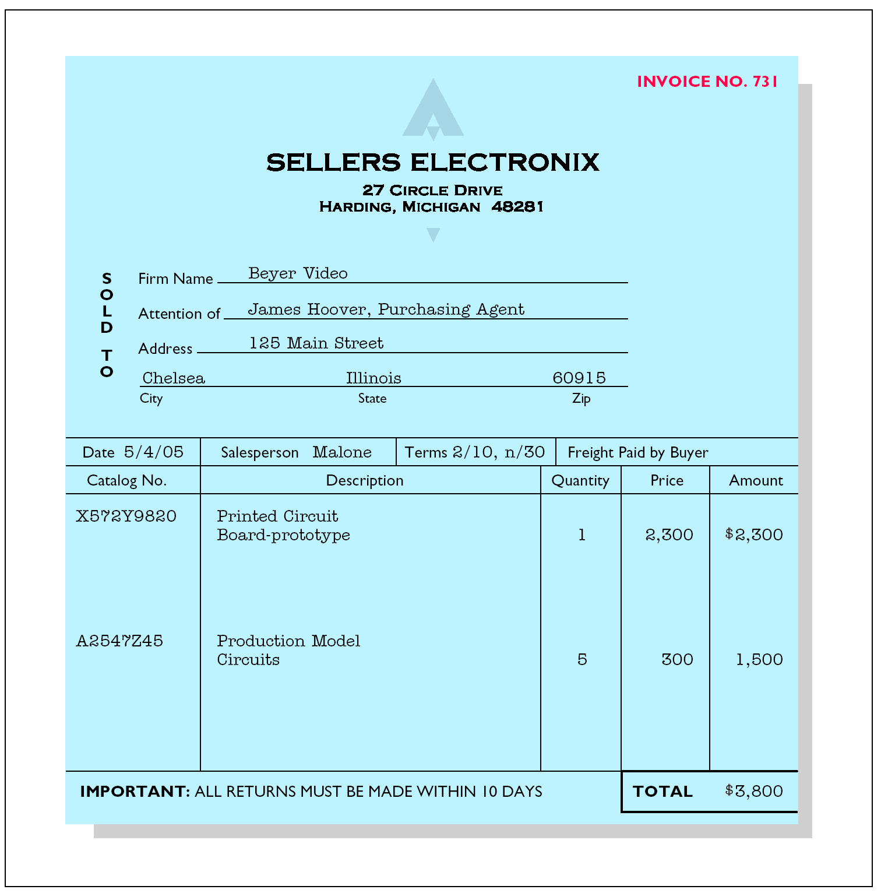
PURCHASES OF MERCHANDISE
SALES INVOICE

Slide 13
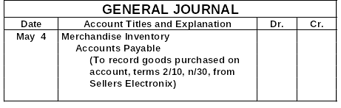
PURCHASES OF MERCHANDISE
3,800
3,800
For purchases on account, Merchandise Inventory is debited and Accounts Payable is credited.

Slide 14
PURCHASE RETURNS AND ALLOWANCES
A purchaser may be dissatisfied with merchandise received because the goods:
1) are damaged or defective,
2) are of inferior quality, or
3) are not in accord with the purchaser’s specifications.
The purchaser initiates the request for a reduction of the balance due through the issuance of a debit memorandum (purchaser’s debit decreases A/P!).
The debit memorandum is a document issued by a buyer to inform a seller that the seller’s account has been debited because of unsatisfactory merchandise.

Slide 15
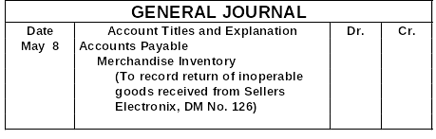
PURCHASE RETURNS AND ALLOWANCES
300
300
For purchases returns and allowances, Accounts Payable is debited and Merchandise Inventory is credited.

Slide 16
FREE ON BOARD
A sales agreement should indicate whether the seller or the buyer is to pay the cost of transporting the goods to the buyer’s place of business.
FOB Shipping Point
  1) Goods placed free on board the carrier by seller
  2) Buyer pays freight costs
FOB Destination
  1) Goods placed free on board at buyer’s business
  2) Seller pays freight costs

Slide 17


ACCOUNTING FOR FREIGHT COSTS
Merchandise Inventory is debited if buyer pays freight.
Freight-out (or Delivery Expense) is debited if seller pays freight.

Slide 18
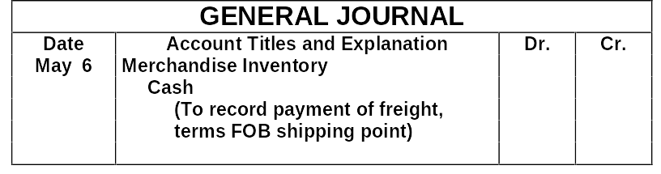
ACCOUNTING FOR FREIGHT COSTS
150
150
When the purchaser directly incurs the freight costs, the account Merchandise Inventory is debited and Cash is credited.

Slide 19
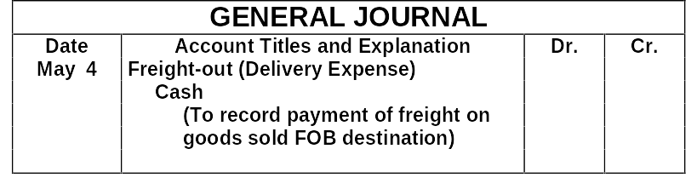
ACCOUNTING FOR FREIGHT COSTS
150
150
Freight costs incurred by the seller on outgoing merchandise are debited to Freight-out (or Delivery Expense) and Cash is credited.

Slide 20

PURCHASE DISCOUNTS
Credit terms may permit the buyer to claim a cash discount for the prompt payment of a balance due.
The buyer calls this discount a purchase discount.
Like a sales discount, a purchase discount is based on the invoice cost less returns and allowances, if any.

Slide 21
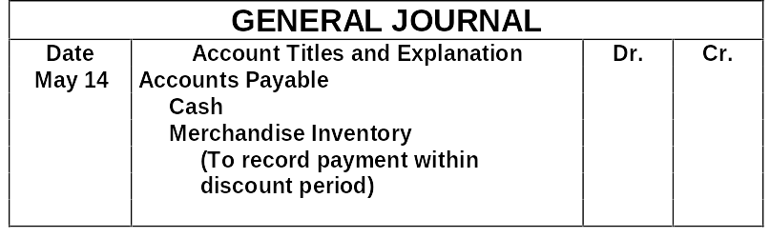
PURCHASE DISCOUNTS
3,500
3,430
70
If payment is made within the discount period, Accounts Payable is debited, Cash is credited, and Merchandise inventory is credited for the discount taken.

Slide 22
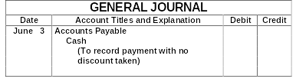
PURCHASE DISCOUNTS
3,500
3,500
If payment is made after the discount period, Accounts Payable is debited and Cash is credited for the full amount.

Slide 23

SAVINGS OBTAINED BY TAKING PURCHASE DISCOUNT
A buyer should usually take all available discounts.
If Beyer Video takes the discount, it pays $70 less in cash.
If it forgoes the discount and invests the $3,500 for 20 days at 10% interest, it will earn only $19.44 in interest.
The savings obtained by taking the discount is calculated as follows:

Slide 24
SALES TRANSACTIONS
STUDY OBJECTIVE 3
Revenues – (Revenue recognition principle)
  Earned when the goods are transferred from seller to buyer
All sales should be supported by a document such as a cash register tape or sales invoice.

Slide 25
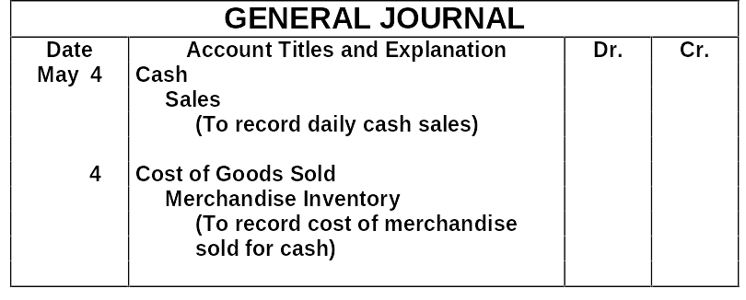
RECORDING CASH SALES
2,200
2,200
1,400
1,400
For cash sales, Cash is debited and Sales is credited.
For the cost of goods sold for cash, Cost of Goods Sold is debited and Merchandise Inventory is credited.

Slide 26
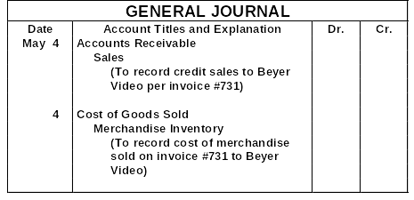
RECORDING CREDIT SALES
3,800
3,800
2,400
2,400
For credit sales, Accounts Receivable is debited and Sales is credited.
For the cost of goods sold on account, Cost of Goods Sold is debited and Merchandise Inventory is credited.

Slide 27

SALES RETURNS AND ALLOWANCES
Sales Returns
  Customers dissatisfied with merchandise and are allowed to return the goods to the seller for credit or a refund.
Sales Allowances
  Result when customers are dissatisfied and the seller allows a deduction from the selling price.

Slide 28
SALES RETURNS AND ALLOWANCES
Credit memorandum
  the seller prepares a form to inform the customer that a credit has been made to the customer’s account receivable
Sales Returns and Allowances
  Contra revenue account to the Sales account
The normal balance of Sales Returns and Allowances is a debit

Slide 29
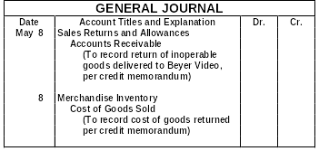
RECORDING SALES RETURNS AND ALLOWANCES
300
300
140
140
The seller’s entry to record a credit memorandum involves a debit to the Sales Returns and Allowances account and a credit to Accounts Receivable. The entry to record the cost of the returned goods involves a debit to Merchandise Inventory and a credit to Cost Goods Sold.

Slide 30
SALES DISCOUNTS
Sales discount
  Offer of a cash discount to a customer for the prompt payment of a balance due
  Is a contra revenue account with a normal debit balance
Example: Credit sale has the terms 3/10, n/30, a 3% discount is allowed if payment is made within 10 days. After 10 days there is no discount, and the balance is due in 30 days.

Slide 31

CREDIT TERMS
Credit terms specify the amount and time period for the cash discount
  Indicates the length of time in which the purchaser is expected to pay the full invoice price
2/10, n/30 A 2% discount may be taken if payment is made
within 10 days of the invoice date.
1/10 EOM A 1% discount is available if payment is made
by the 10th of the next month.

Slide 32
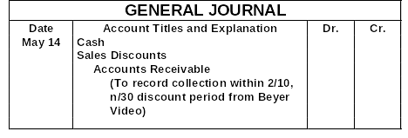
RECORDING
SALES DISCOUNTS
3,430
70
3,500
When cash discounts are taken by customers, the seller debits Sales Discounts.

Slide 33
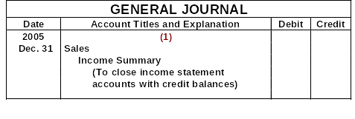
CLOSING ENTRIES
STUDY OBJECTIVE 4
Adjusting entries are journalized from the adjustment columns of the work sheet.
All accounts that affect the determination of net income are closed to Income Summary.
Data for the preparation of closing entries may be obtained from the income statement columns of the work sheet.
480,000
480,000

Slide 34
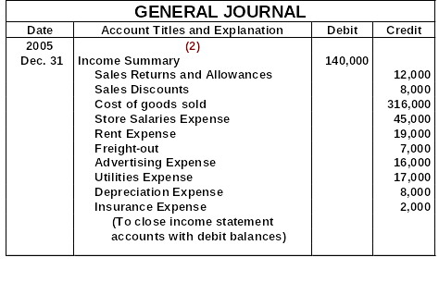
CLOSING ENTRIES
Cost of Goods Sold is a new account that must be closed to Income Summary.

Slide 35
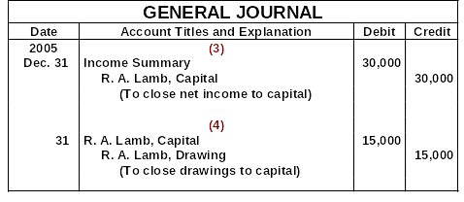
CLOSING ENTRIES
After the closing entries are posted, all temporary accounts have zero balances
It addition, R. A. Lamb, Capital has a credit balance of $98,000 ($83,000 + $30,000 - $15,000).

Slide 36
Under a perpetual inventory system, acquisition of merchandise for resale is debited to the
  purchases account
  supplies account
  merchandise inventory account
  cost of goods sold account

Slide 37
Under a perpetual inventory system, acquisition of merchandise for resale is debited to the
  purchases account
  supplies account
  merchandise inventory account
  cost of goods sold account

Slide 38
MULTIPLE-STEP INCOME STATEMENT
STUDY OBJECTIVE 5
Includes sales revenue, cost of goods sold, and gross profit sections
Additional nonoperating sections may be added for:
  1) revenues and expenses resulting from secondary or auxiliary operations
  2) gains and losses unrelated to operations

Slide 39
MULTIPLE-STEP INCOME STATEMENT
Operating expenses may be subdivided into:
a) Selling expenses
b) Administrative expenses
Nonoperating sections are reported after income from operations and are classified as:
a) Other revenues and gains
b) Other expenses and losses

Slide 40
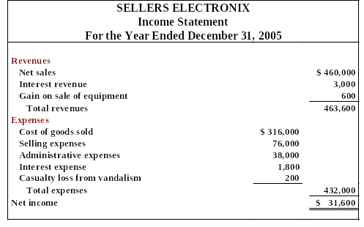
SINGLE-STEP INCOME STATEMENT
All data are classified under two categories: 1 Revenues
2 Expenses
Only one step is required in determining net income or net loss.

Slide 41
COMPUTATION OF GROSS PROFIT
STUDY OBJECTIVE 6
Gross profit is determined as follows:
Net sales $ 460,000
Cost of goods sold 316,000
Gross profit $ 144,000

Slide 42
OPERATING EXPENSES IN COMPUTING NET INCOME
Net income is determined as follows:
Gross profit $ 144,000
Operating expenses 114,000
Net income $ 30,000

Slide 43
Gross profit for a merchandiser is net sales minus
  operating expenses
  cost of goods sold
  sales discounts
  cost of goods available for sale

Slide 44
Gross profit for a merchandiser is net sales minus
  operating expenses
  cost of goods sold
  sales discounts
  cost of goods available for sale

Slide 45
PERIODIC INVENTORY SYSTEMS
Appendix 5A
Revenues from the sale of merchandise are recorded when sales are made in the same way as in a perpetual system
No attempt is made on the date of sale to record the cost of merchandise sold
Physical inventories are taken at end of period to determine:
  The cost of merchandise on hand
  The cost of the goods sold during the period

Slide 46
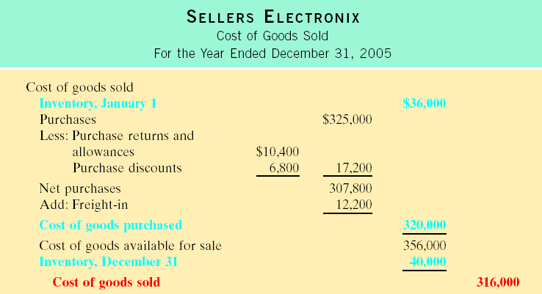
Determining Cost of Goods Sold
Periodic
STUDY OBJECTIVE 7
Notes:
This is the slide you sent me awhile back. Notice that the blue does not show up well in a screen situation. Any suggestions?

Slide 47

RECORDING MERCHANDISE TRANSACTIONS UNDER A PERIODIC INVENTORY SYSTEM
Purchases
  Merchandise purchased for resale to customers
  May be made for cash or on account (credit)
  Normally recorded by the purchaser when the goods are received from the seller
  Credit purchase should be supported by a purchase invoice

Slide 48
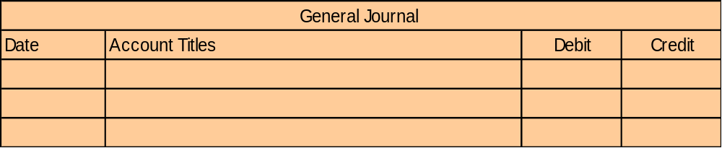
RECORDING PURCHASES OF MERCHANDISE
May 4 Purchases 3,800
Accounts Payable 3,800
To illustrate the recording of merchandise transactions under a periodic system, we will use the purchase/sale transactions between Seller and Buyer. For purchases on account, Purchases is debited and Accounts Payable is credited for merchandise ordered from Seller.

Slide 49

PURCHASE RETURNS AND ALLOWANCES
A sales return and allowance on the seller’s books is recorded as a purchase return and allowance on the books of the purchaser.
Purchase Returns and Allowances
  contra account to Purchases
  Normal credit balance
Debit memorandum
  Purchaser initiates the request for a reduction of the balance due through the issuance of a debit memorandum
  A document issued by a buyer to inform a seller that the seller’s account has been debited because of unsatisfactory merchandise

Slide 50
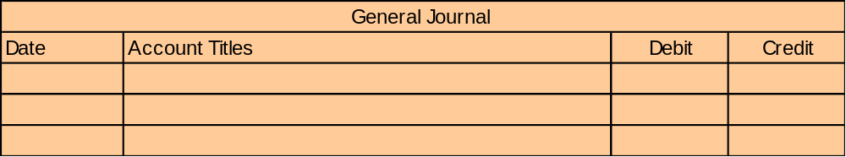
RECORDING PURCHASE RETURNS AND ALLOWANCES
May 8 Accounts Payable 300
Purchase Returns and Allowances 300
For purchases returns and allowances, Accounts Payable is debited and Purchase Returns and Allowances is credited. Because $300 of merchandise received from Seller is inoperable, Buyer returns the goods and issues a debit memo.

Slide 51


ACCOUNTING FOR FREIGHT COSTS
Freight-in is debited if buyer pays freight
Freight-out (or Delivery Expense) is debited if seller pays freight

Slide 52
ACCOUNTING FOR FREIGHT COSTS
May 9 Freight-in 150
Cash 150
When the purchaser directly incurs the freight costs, the account Freight-in (or Transportation-in) is debited and Cash is credited. In this example, Buyer pays Acme Freight Company $150 for freight charges on its purchase from Seller.

Slide 53
PURCHASE DISCOUNTS
Credit terms may permit the buyer to claim a cash discount for the prompt payment of a balance due.
The buyer calls this discount a purchase discount.
Like a sales discount, a purchase discount is based on the invoice cost less returns and allowances, if any.

Slide 54
PURCHASE DISCOUNTS
May 14 Accounts Payable 3,500
Purchase Discounts 70
Cash 3,430
If payment is made within the discount period, Accounts Payable is debited, Purchase Discounts is credited for the discount taken, and Cash is credited. On May 14 Buyer pays the balance due on account to Seller taking the 2% cash discount allowed by Seller for payment within 10 days.

Slide 55
RECORDING SALES OF MERCHANDISE
May 4 Accounts Receivable 3,800
Sales 3,800
For credit sales, Accounts Receivable is debited and Sales is credited. In this illustration, the sale of $3,800 of merchandise to Buyer on May 4 is recorded by the Seller.

Slide 56
RECORDING SALES RETURNS AND ALLOWANCES
May 8 Sales Returns and Allowances 300
Accounts Receivable 300
The seller’s entry to record a credit memorandum involves a debit to the Sales Returns and Allowances account and a credit to Accounts Receivable. Based on the debit memo received from Buyer on May 8 for returned goods, Seller records the $300 sales returns above.

Slide 57
RECORDING
SALES DISCOUNTS
May 15 Cash 3,430
Sales Discounts 70
Accounts Receivable 3,500
When cash discounts are taken by customers, the seller debits Sales Discounts. On May 15, Seller receives payment of $3,430 on account from Buyer. Seller honors the 2% discount and records the payment of Buyer’s accounts receivable.

Slide 58
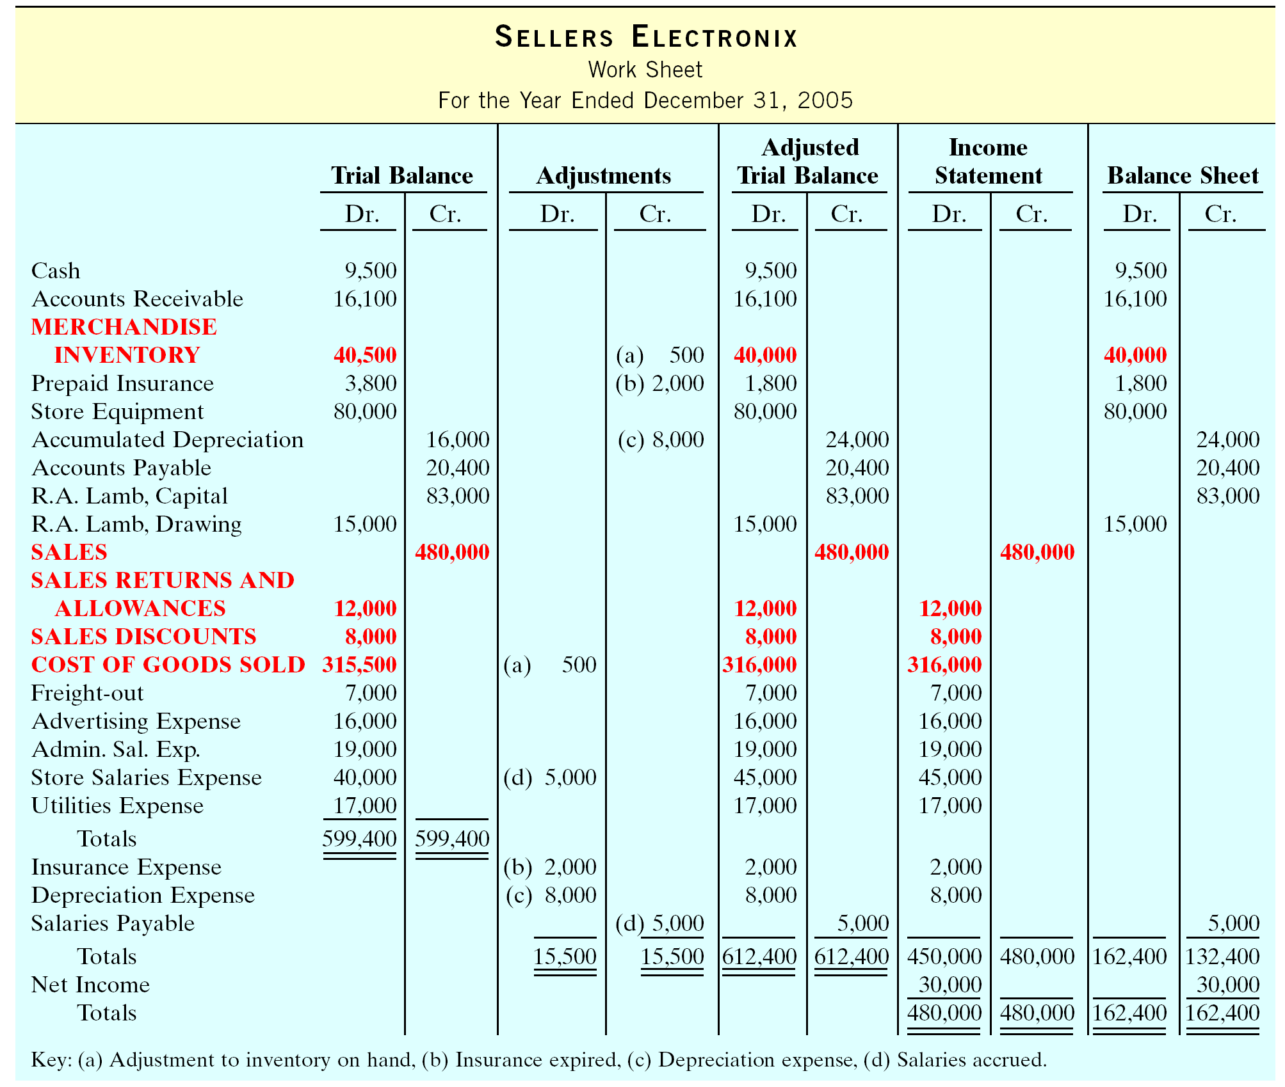
WORK SHEET FOR A MERCHANDISING COMPANY
Notes:
Fix me!!!!!!!!!!!!!!!!!!!!!!!!!1

Slide 59
USING A WORK SHEET
Appendix 5B
Trial Balance Columns
1 Data from the trial balance are obtained from the ledger balances of Sellers Electronix at December 31
2 The amount shown for Merchandise Inventory, $40,500, is the year-end inventory amount which results from the application of a perpetual inventory system

Slide 60
USING A WORK SHEET
Adjustments Columns
1 A merchandising company usually has the same types of adjustments as a service company
2 Work sheet adjustments b, c, and d are for insurance, depreciation, and salaries
Adjusted Trial Balance - The adjusted trial balance shows the balance of all accounts after adjustment at the end of the accounting period

Slide 61
USING A WORK SHEET
Income Statement Columns
1 The accounts and balances that affect the income statement are transferred from the adjusted trial balance columns to the income statement columns for Sellers Electronix at December 31
2 All of the amounts in the income statement credit column should be totaled and compared to the total of the amounts in the income statement debit column

Slide 62
USING A WORK SHEET
Balance Sheet Columns
1 The major difference between the balance sheets of a service company and a merchandising company is inventory
2 For Sellers Electronix, the ending Merchandise Inventory amount of $40,000 is shown in the balance sheet debit column
3 The information to prepare the owner’s equity statement is also found in these columns

Slide 63

COPYRIGHT
Copyright © 2005 John Wiley & Sons, Inc. All rights reserved. Reproduction or translation of this work beyond that permitted in Section 117 of the 1976 United States Copyright Act without the express written consent of the copyright owner is unlawful. Request for further information should be addressed to the Permissions Department, John Wiley & Sons, Inc. The purchaser may make back-up copies for his/her own use only and not for distribution or resale. The Publisher assumes no responsibility for errors, omissions, or damages, caused by the use of these programs or from the use of the information contained herein.

